Slide 1
Active AI Projects at WIPO
AI applied to text in international classifications:
For automatic text classification in the International Patent Classification: IPCCAT-Neural (see related presentations)
For Trade Marks, Nice classification :NCLCAT-Neural
WIPO and Artificial Intelligence

Slide 2
IPCCAT-neural: Automatic text categorization in the IPC
What is it about?
  International Patent Classifications : IPC (and CPC)
  Automatic text CATegorization (in the specific context of patent documents)
  AI-based solution, trained to mimic legacy IPC classification of patent documents in the IPC reference database
  Large collections of classified patent documents for this training
WIPO and Artificial Intelligence

Slide 3
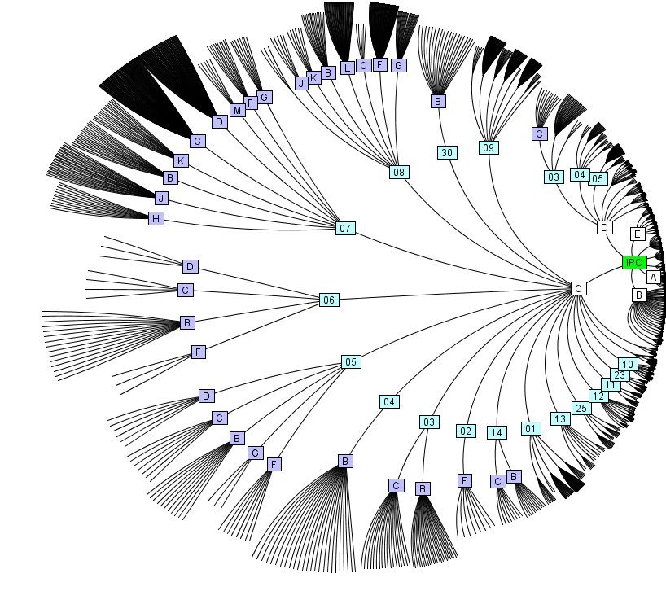

IPCCAT challenge: predictions among ~73,000
WIPO and Artificial Intelligence

Slide 4

IPCCAT-neural
Problems to be addressed:
    Availability of various technical expertise e.g. in small Patent Offices
    For one document, several IPC symbols needed with an indicative level of confidence in each guess
    Documents to be classified are in various languages
    The IPC classification of the same document done twice by human classifiers may not give twice the same result
  Typical usage since 2003:
    Automatic routing of electronic documents based on the technical content of their text e.g. of a patent abstract

Slide 5
IPCCAT-neural performance evaluation challenge
Precision versus recall for IPC: Highest precision for the top IPC guess is not the best option in the domain of patents (e.g. in prior art search)
WIPO and Artificial Intelligence

Slide 6
IPCCAT-neural English in a nutshell
  Baseline of the solution:
    Un-supervised training for ~8,000+ neural networks, with 30 million of already classified patent documents in English (see WIPO-delta dataset)
    Several IPC predictions with confidence levels
    Retrained every year (new vocabulary, IPC revisions, patent reclassification,…)
    IPC Coverage and accuracy of predictions measured on millions of test cases
    Other languages also need consideration…
WIPO and Artificial Intelligence

Slide 7
IPCCAT-neural is now cross lingual
Large collection of EN documents however input text may not always be in English…
30 Mo of EN Patent Documents with IPC
Input text in XX language
IPCCAT EN
IPC guess for text in XX language
WIPO translate: XX into EN
WIPO and Artificial Intelligence

Slide 8
IPCCAT-neural cross-lingual 2019 performance
  Automatic prediction among 99% of the IPC i.e. among 73,633 categories
  Three guess precision: 84%!
  9 supported language : Arabic, German, Spanish, French, Korean, Japanese, Portuguese, Russian, Chinese.
WIPO and Artificial Intelligence

Slide 9
IPCCAT-neural cross-lingual potential use
Consistency of AI-based IPC classification:
  IPCCAT mimics the legacy usage of the IPC in DOCDB (the IPC reference patent database)
  IPCCAT classification of the same document done twice, gives twice the same IPCs
WIPO and Artificial Intelligence

Slide 10
NCLCAT-neural project
2017 Proof of Concept: Potential use of AI for the Nice classification (NCL)
  AI support to NCL is promising however training sets were too small
2019: Larger training collections, Madrid Goods and Service (MGS)
  Prediction of NCL 11 Classes for query terms: > 99.5% accuracy
  Proposal of possibly related MGS terms (in progress)
  Languages : EN, FR, ES
  Outcomes of Research and development in Q4 2019…
WIPO and Artificial Intelligence

